Slide 1


Slide 2



Analyzing product reviews to find insights with Cognitive Services
Roberto Freato – Azure MVP
Consultant / Author / Solution Architect

Slide 3
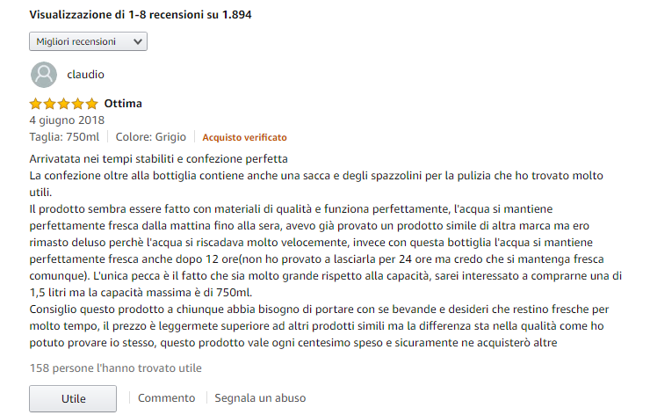
Product reviews

Slide 4
Business intent
Automate the high-level analysis of (bad) reviews
Set the overall product trend
Identify the reviews where to focus by answering
Look for similarities

Slide 5
Text Analytics https://azure.microsoft.com/it-it/services/cognitive-services/text-analytics/

Slide 6
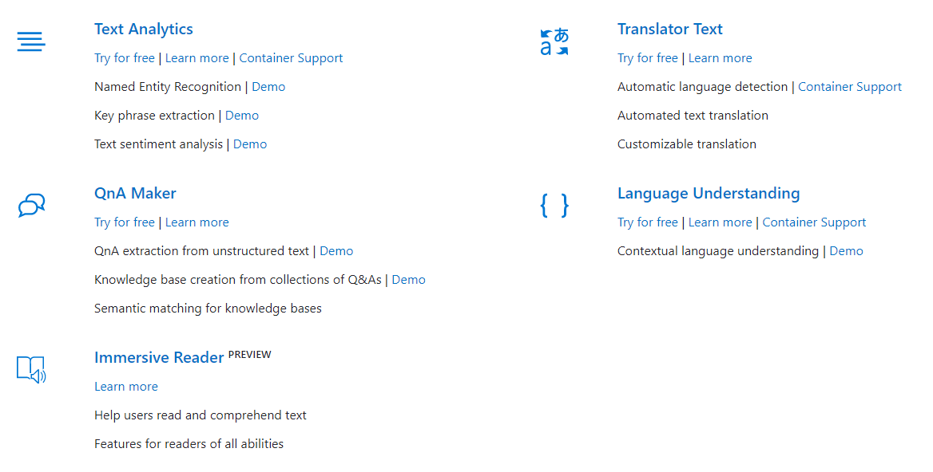
Cognitive Services - Language

Slide 7
API Explorer https://westeurope.dev.cognitive.microsoft.com/docs/services/TextAnalytics-v2-1

Slide 8
Exploring the DataSet

Slide 9
.NET Core SDK

Slide 10
Why it’s a search topic
Find the most relevant reviews
What is the relevance?
Experiment different ordering without change the code
Look for similarities to refine search
Eventually, find reviews by text terms

Slide 11
Azure Search integration and enrichment
Notes:
- Query1: $filter=Sentiment/all(sent: sent lt 0.3) and Rating lt 4
- Query2: &search=&moreLikeThis=R1ELHGEEAKGZ97&searchFields=Keyphrases

Slide 12
What’s not covered today
Custom skillsets to create specific enriched fields
Scoring profiles to determine multiple ordering logics
Multiple language support and best-practices

Slide 13
Analyzing product reviews to find insights with Cognitive Services
Roberto Freato – Azure MVP
Consultant / Author / Solution Architect

